Slide 1
covid analysis
By:- Anmol Malviya

Slide 2


Slide 3
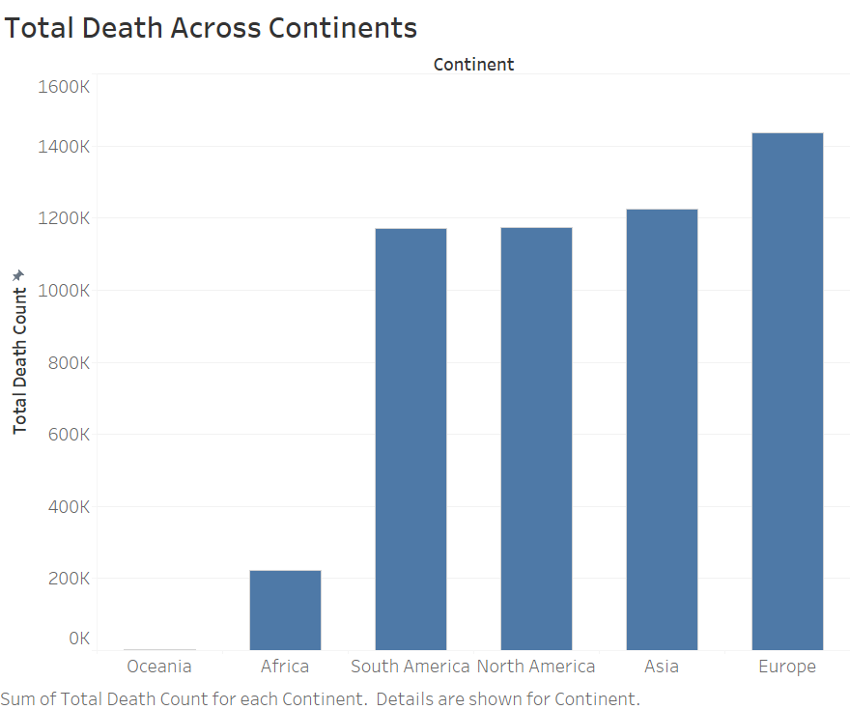

Slide 4
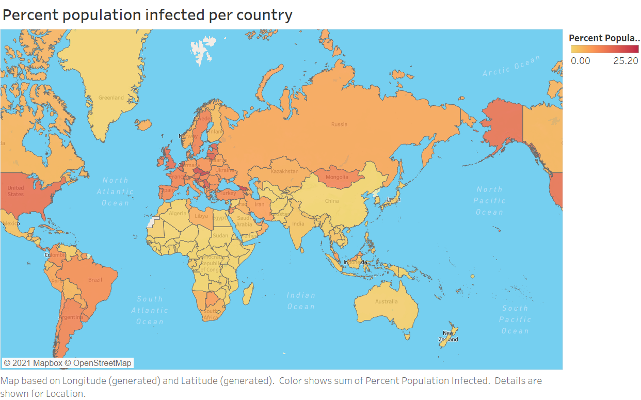

Slide 5
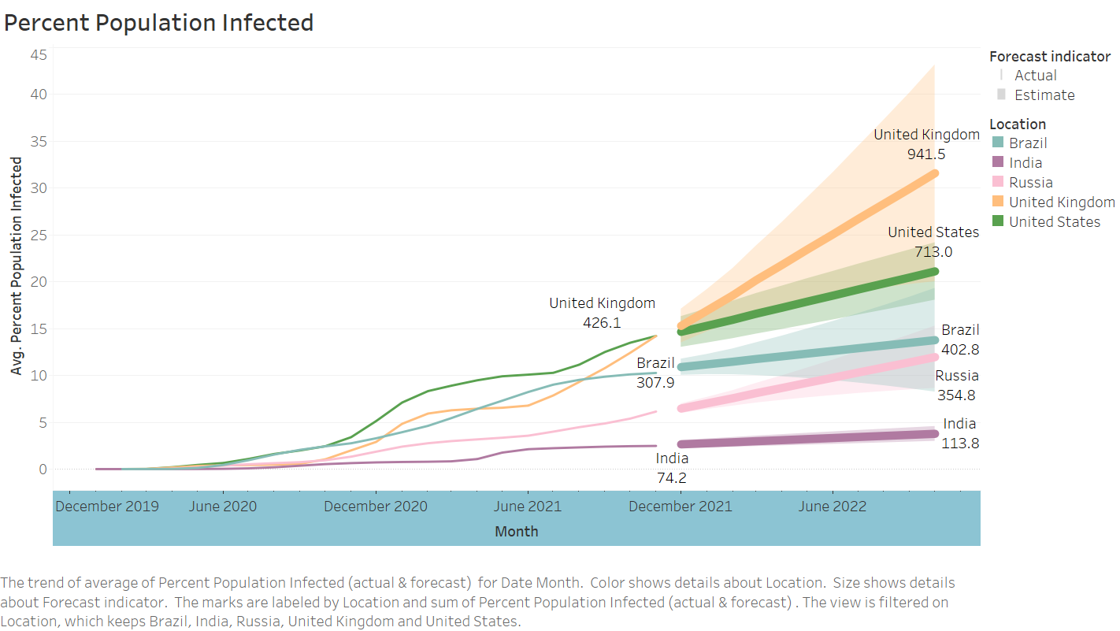

Slide 6
